Slide 1
Recap lecture 10
Definition of GTG, examples of GTG accepting the languages of strings:containing aa or bb, beginning with and ending in same letters, beginning with and ending in different letters, containing aaa or bbb,
Nondeterminism, Kleene’s theorem (part I, part II, part III), proof of Kleene’s theorem part I

Slide 2
Kleene’s Theorem continued …
Proof(Kleene’s Theorem Part II)
To prove part II of the theorem, an algorithm consisting of different steps, is explained showing how a RE can be obtained corresponding to the given TG. For this purpose the notion of TG is changed to that of GTG i.e. the labels of transitions are corresponding REs.

Slide 3
Kleene’s Theorem part II continued …
Basically this algorithm converts the given TG to GTG with one initial state along with a single loop, or one initial state connected with one final state by a single transition edge. The label of the loop or the transition edge will be the required RE.
Step 1 If a TG has more than one start states, then introduce a new start state connecting the new state to the old start states by the transitions labeled by Λ and make the old start states the non-start states. This step can be shown by the following example

Slide 4
Example
b
b
1-
3+
aa
a
a
2-
4+
bb

Slide 5
Example Continued ...
b
b
1
3+
Λ
aa
-
a
Λ
a
2
4+
bb

Slide 6
Kleene’s Theorem part II continued …
Step 2:
If a TG has more than one final states, then introduce a new final state, connecting the old final states to the new final state by the transitions labeled by Λ.
This step can be shown by the previous example of TG, where the step 1 has already been processed

Slide 7
Example
b
b
1
3+
Λ
aa
-
a
Λ
a
2
4+
bb

Slide 8
Example continued …
b
b
1
3
Λ
aa
Λ
-
a
Λ
a
+
Λ
2
4
bb

Slide 9
Kleene’s Theorem part II continued …
Step 3:
If a state has two (more than one) incoming transition edges labeled by the corresponding REs, from the same state (including the possibility of loops at a state), then replace all these transition edges with a single transition edge labeled by the sum of corresponding REs.
This step can be shown by a part of TG in the following example

Slide 10
Example
r₃
The above TG can be reduced to
r₁
….
5
4
….
r₂
r₄
r₃+r₄
r₁+r₂
….
5
4
….

Slide 11
Note
The step 3 can be generalized to any finite number of transitions as shown below
The above TG can be reduced to
r₁
r₂
….
5
….
….
r_{n}
…
r₁+r₂ + +r_{n}
….
5
….

Slide 12
Kleene’s Theorem part II continued …
Step 4 (bypass and state elimination)
If three states in a TG, are connected in sequence then eliminate the middle state and connect the first state with the third by a single transition (include the possibility of circuit as well) labeled by the RE which is the concatenation of corresponding two REs in the existing sequence. This step can be shown by a part of TG in the following example

Slide 13
Example
r₃
r₂
r₄
….
4
5
6
….
To eliminate state 5 the above can be reduced to
r₂r₃*r₄
….
….
4
6
Consider the following example containing a circuit

Slide 14
Example
Consider the part of a TG, containing a circuit at a state, as shown below
To eliminate state 3 the above TG can be reduced to
r₂
r₃
r₁
3
4
….
….
2
r₄
r₄r₂*r₃
r₁r₂*r₃
….
….
2
4

Slide 15
Example
Consider a part of the following TG
To eliminate state 3 the above TG can be reduced to
r₂
r₁
r₃
r₇
r₉
r₅
….
2
3
4
….
r₄
r₈
r₆

Slide 16
Example continued ...
To eliminate state 4 the above TG can be reduced to
r₁ +r₃ r₅* r₄
r₉ + r₈r₅*r₇
r₂ +r₃ r₅* r₇
….
2
4
….
r₆ + r₈r₅*r₄
(r₁ +r₃ r₅* r₄ )+(r₂ +r₃ r₅* r₇ )(r₉ +r₈ r₅* r₇ )*(r₆ +r₈ r₅* r₄ )
….
2
….

Slide 17
Note
It is to be noted that to determine the RE corresponding to a certain TG, four steps have been discussed. This process can be explained by the following particular examples of TGs

Slide 18
Example
Consider the following TG
To have single final state, the above TG can be reduced to the following
aa,b
2+
aaa
-
ab,ba
1
bba
3+

Slide 19
Example continued …
aa+b
To eliminate states 2 and 3, the above TG can be reduced to the following
The above TG can be reduced to the following
2
aaa
Λ
-
ab+ba
1
4+
bba
Λ
3
aa+b
-
ab+ba
aaa Λ+bbaΛ
1
4+

Slide 20
Example continued …
To eliminate state 1 the above TG can be reduced to the following
Hence the required RE is (ab+ba)(aa+b)*(aaa+bba)
-
(ab+ba)(aa+b)*(aaa+bba)
+

Slide 21
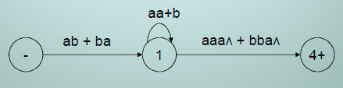

Kleene’s Theorem
  To eliminate state 2 and 3, the above TG cab be reduced to
  To eliminate state 1 the above TG can be reduced to
  Hence the required RE is (ab + ba) (aa+b)* (aaa+bba)

Slide 22
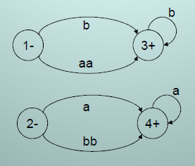
Kleene’s Theorem
Example:
  To have single initial and single final state the above TG can be reduced to the following

Slide 23
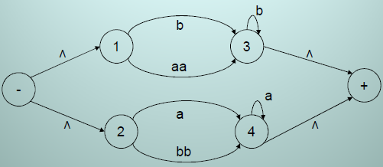
Kleene’s Theorem
  To obtain single transition edge between 1 and 3; 2 and 4, the above TG can be reduced to the following

Slide 24
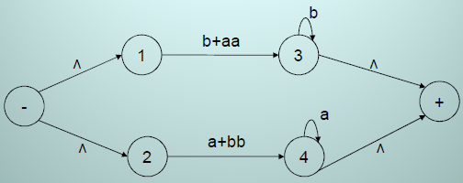
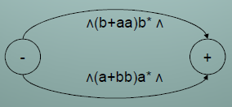
Kleene’s Theorem
  To obtain single transition edge between 1 and 3; 2 and 4, the above TG can be reduced to the following

Slide 25

Kleene’s Theorem
  To connect the initial state with the final state by single transition edge, the above TG can be reduced to the following
  Hence the required RE is (b+aa)b* +(a+bb)a*

Slide 26
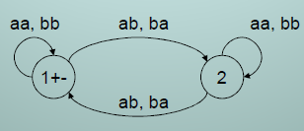
Kleene’s Theorem
Example:
  Consider the following TG accepting Even-Even Language
  To have single initial and single final state the above TG can be reduced to the following

Slide 27
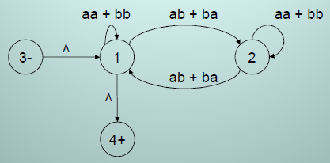
Kleene’s Theorem
  To eliminate state 2 the above TG can be reduced to the following

Slide 28
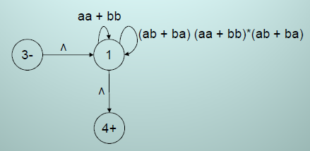
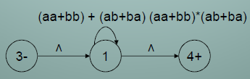
Kleene’s Theorem
  To have single loop at state 1 the above TG can be reduced to the following

Slide 29

Kleene’s Theorem
  To eliminate state 1 the above TG can be reduced to the following
  Hence the required RE is ((aa+bb) + (ab, ba) (aa, bb)*(ab, ba))*

Slide 30
Summing Up
proof of Kleene’s theorem part II (method with different steps), particular examples of TGs to determine corresponding Res.

